Slide 1
Operating System Project
Mind Units Team
Ibrahim Taghizada
Hajar Naghiyeva
Aykhan Aghayev

Slide 2
TABLE OF CONTENTS
01
02
03
Result
Task & Solution
OUR PROCESS
Implementation of scheduling algorithms by collaboratively working in a team
Each team member worked on the logic and implementation of a certain scheduling algorithm relying on joint discussions
Upon the completion of each scheduling algorithm, we structured the whole program and created readme file for the design notes

Slide 3
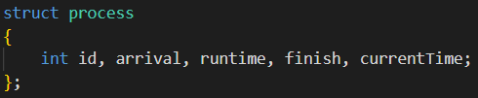
Explaining Code – struct “process”
Every process is kept as a struct named “process”. It has 5 fields:
1. id -> the id of the process
2. arrival -> the arrival time of the process
3. runtime -> how long the process will be run for
4. finish -> when did the process finish after a certain scheduling algorithm did its job
5. currentTime -> how long has this process been running till now (now referring to some time when the scheduling algorithm was working)

Slide 4
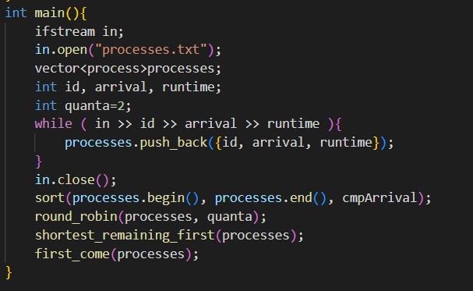
Explaining Code – “main()” function
“main” function:
Input stream for reading files is created
Input is taken from the “processes.txt”
Inputs are converted into “process” struct and kept in std::vector
Processes are sorted by their arrival time
Scheduling algorithms are being ran one by one

Slide 5
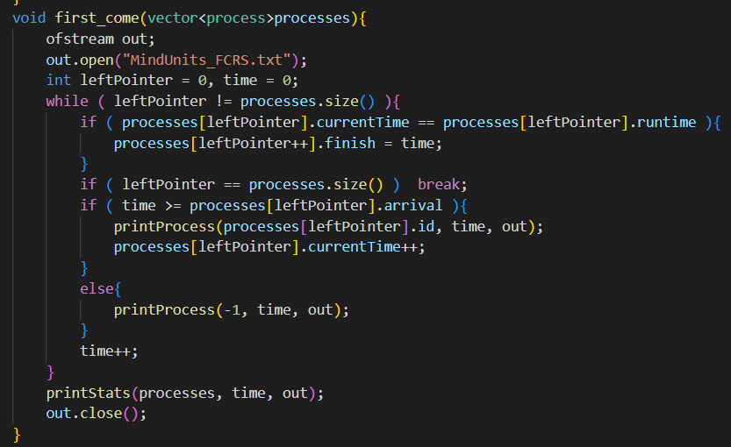
Explaining Code – FCFS algorithm
First-Come-First-Served:
processes should be run when they come, until they are finished
a pointer (leftPointer) pointing at the current process that is running
a variable that keeps track of what time we are at now

Slide 6
Explaining Code - FCFS algorithm
First-Come-First-Served:
check if the current process is finished (currentTime = runtime)
if yes, update its finish time (for calculating statistics) and move the pointer to the next process
if no, take the process the pointer is pointing at and update its runtime
print running process and increase time

Slide 7
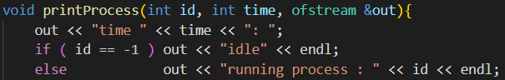
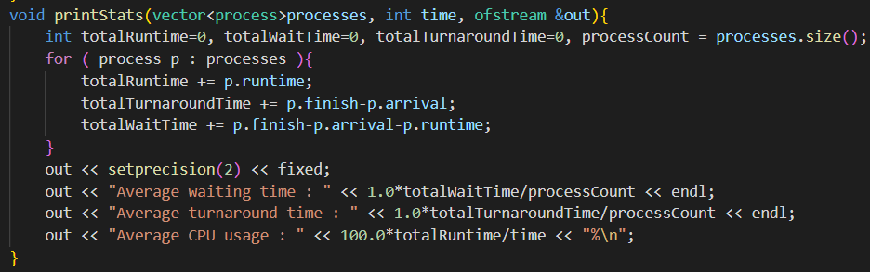
Explaining Code – printProcess & printStats
First-Come-First-Served:
if no processes, print “idle” by sending -1 as “id” to “printProcess”
after all the processes are finished, we print the statistics about wait time, turnaround time, and CPU usage

Slide 8
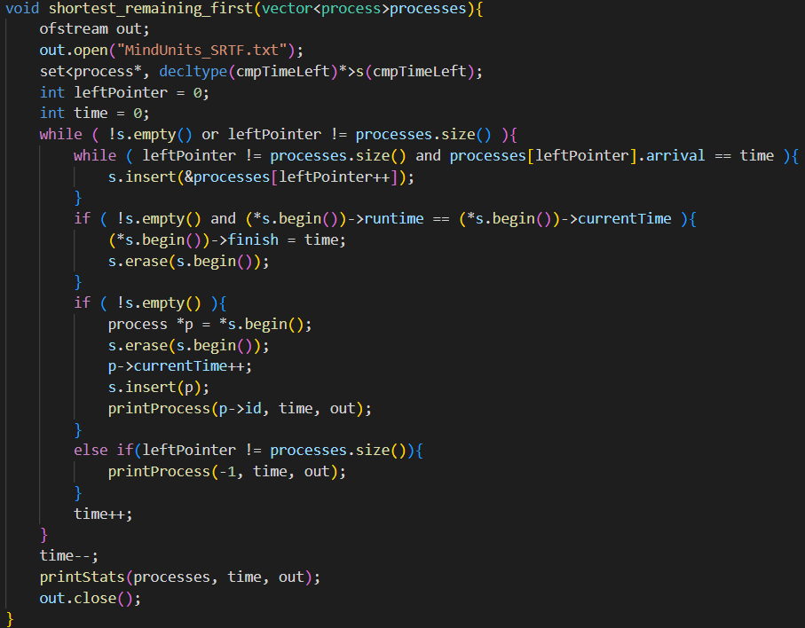
Explaining Code – Shortest Remaining Time First
Shortest Remaining Time First:
Need to know which process has the least time remaining
Using vector for that – slow
Use std::set
As before, we still have a pointer and time.

Slide 9
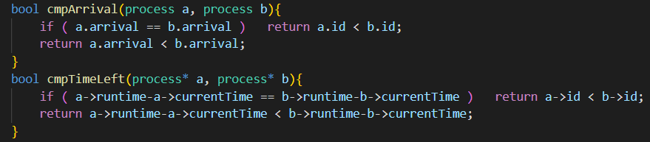
Explaining Code – Shortest Remaining Time First
Shortest Remaining Time First:
To sort processes by their remaining time, implemented a custom comparator and used it for the set

Slide 10
Explaining Code – Shortest Remaining Time First
Shortest Remaining Time First:
process all the processes until there are none left
add all the processes that start at the current time to the set
then take the first element of the set, which is the one with the shortest remaining time

Slide 11
Explaining Code – Shortest Remaining Time First
Shortest Remaining Time First:
If it is finished, update its finish time and remove it from set
If there is any element in the set, update the first one, as it will be the one to be run at the current time
However, we cannot just update it because set rebalances itself only when something is inserted into or deleted from it
Remove and insert it again, which will take log2(n) time
Print the process that will be run now and increase the time
After all the processes are finished, we print the stats

Slide 12
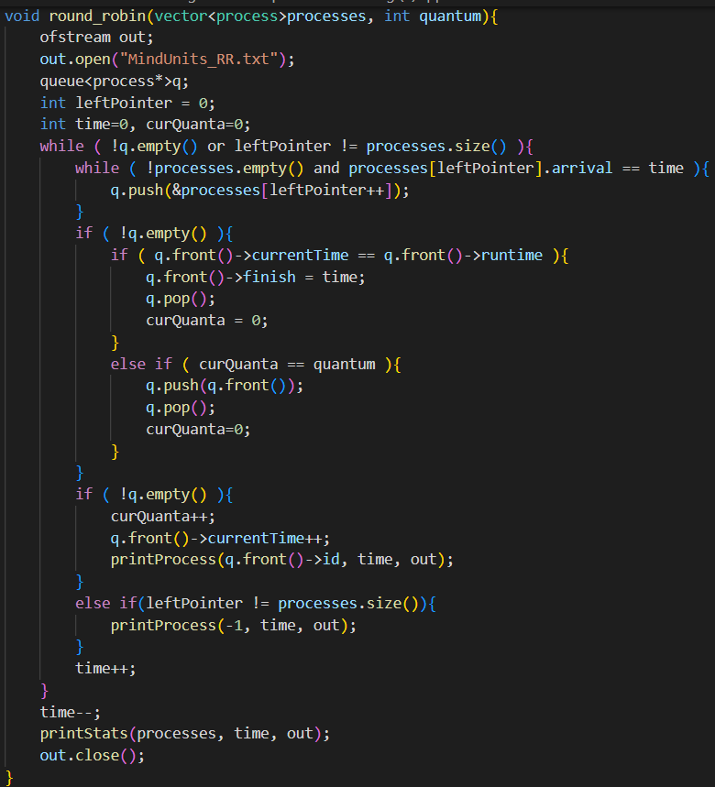
Explaining Code – Round-Robin Algorithm
Round-Robin Algorithm:
used queue instead of set because we need first come, first served at the core but not to let any process work for a long time
have additional curQuanta to show how much of the quantum has been used at the time “time”
the processing starts

Slide 13
Explaining Code – Round-Robin Algorithm
Round-Robin Algorithm:
add all the processes that start at the current time
check if the process that was running has finished
if yes, then we reset the current quanta, remove it from the queue, and update its finish time
if no, we check to see if the time given for the process is up

Slide 14
Explaining Code – Round-Robin Algorithm
Round-Robin Algorithm:
If time is up, remove the process and add it to the end of the queue, then reset the current quanta
then run the process that is at the front of the queue, update quanta and process
print process and update the time
at the end, print stats again

Slide 15
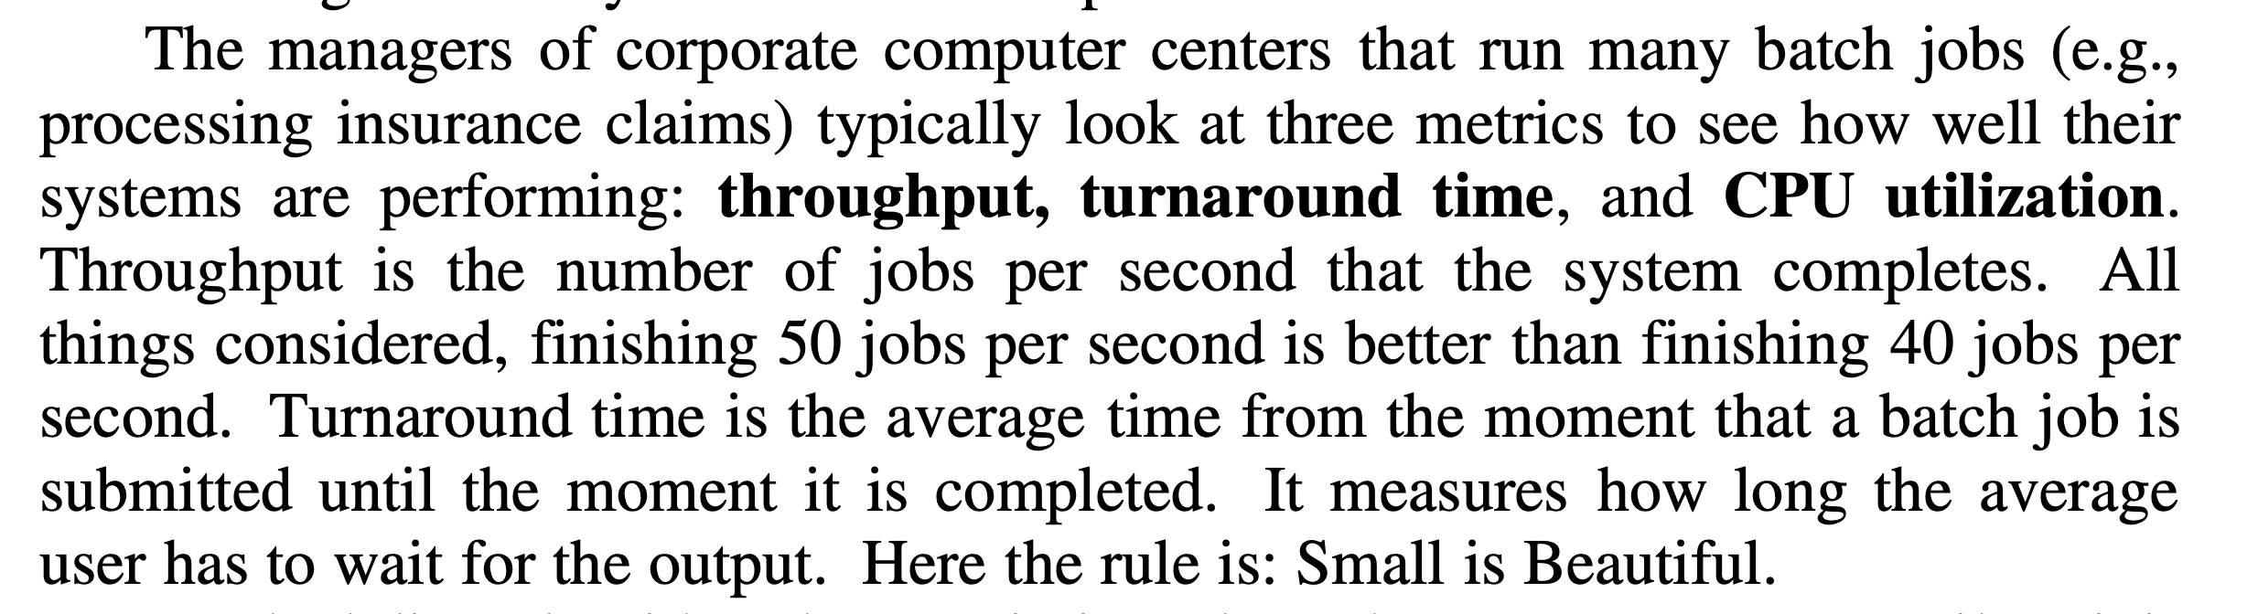
Some Significant Notes – Turnaround Time

Slide 16
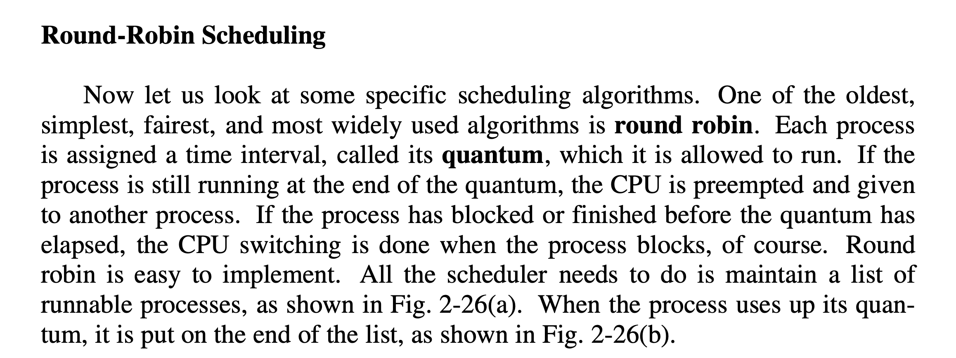
Some Significant Notes - Quantum

Slide 17

References
Andrew S, T., & Herbert, B. (2015). Modern Operating Systems.-4th.

Slide 18
Thank you! ☺

